Slide 1
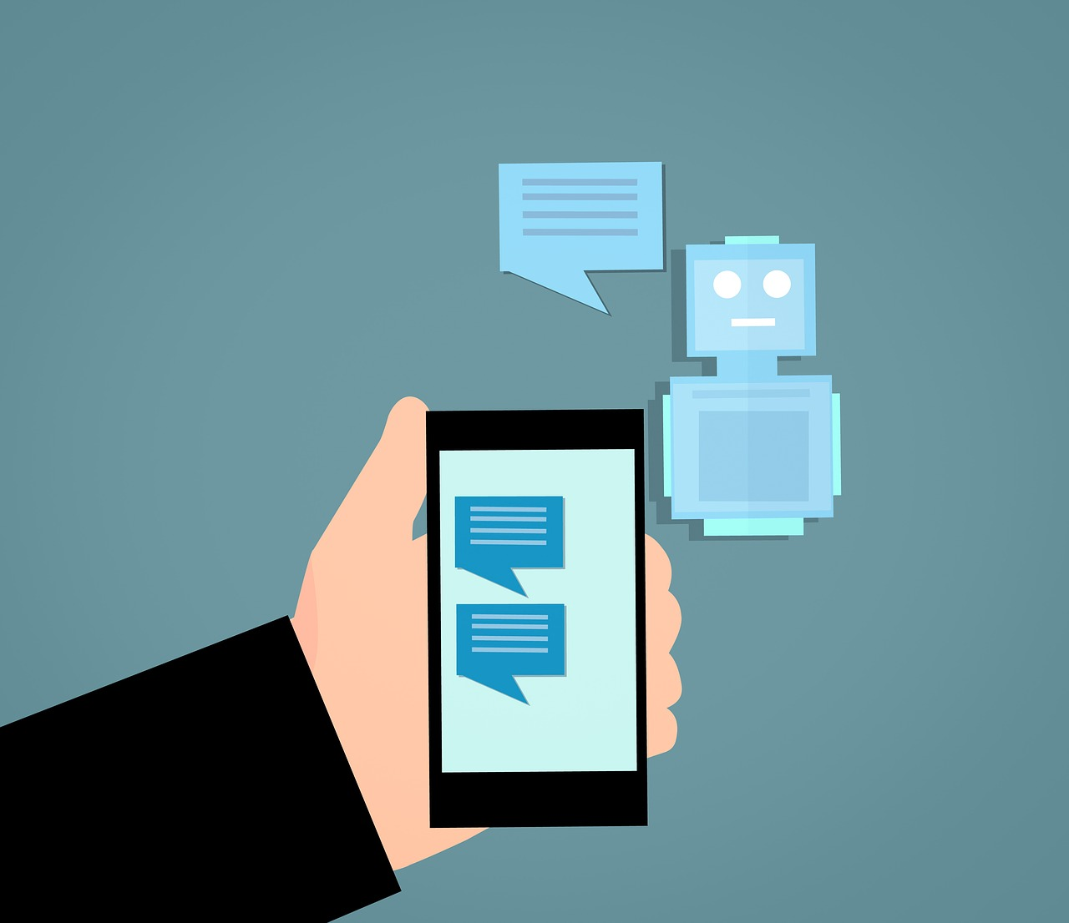
UriaTech
A Conversational AI Solution
for Student-Faculty Interaction

Slide 2

Mission statement:
Revolutionizing digital interaction with AI-powered voice-enabled chatbots for smarter, faster, and more accessible communication.

Slide 3
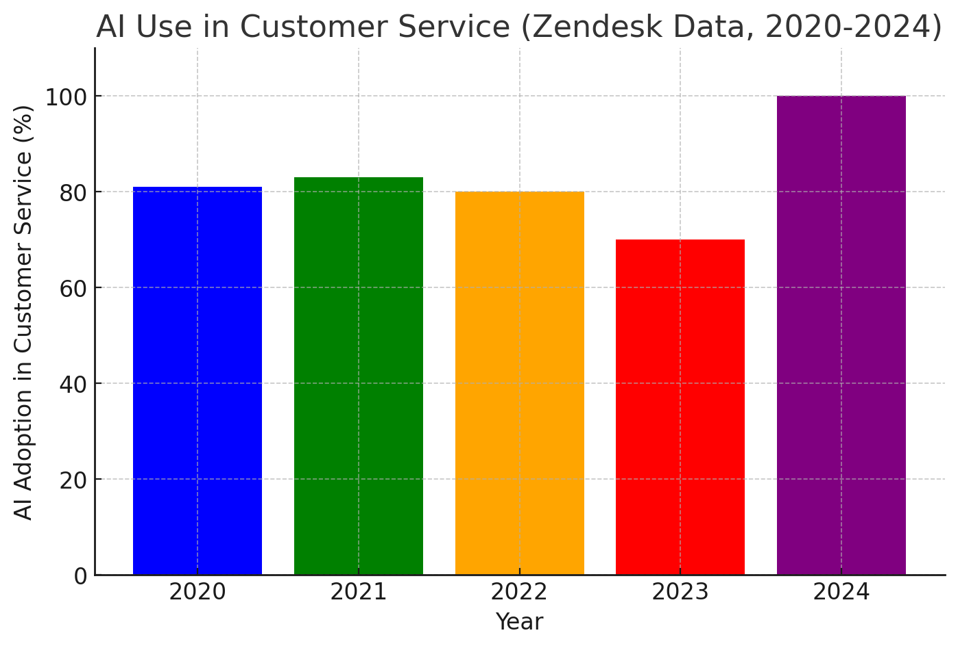
The problem
• Users often struggle to get instant answers on websites.
• Many businesses rely on inefficient customer support methods.
• Speech-based interaction is becoming a necessity for accessibility.
Source: Zendesk. "AI Customer Service Statistics," 2024. zendesk.com

Slide 4

The solution
AI-powered chatbot with speech-to-text capabilities – Enables voice interaction for seamless user experience.
Seamless integration as a plugin on websites – Easily embeds into university websites for quick access.
24/7 automated student support – Instantly answers FAQs about courses, admissions, and schedules.
Personalized responses and recommendations – Provides tailored guidance based on user queries.

Slide 5
Benefits
• Faster and more accessible user support.
• Enhances website interactivity.
• Can handle multiple users simultaneously.
• Reduces manual workload for the department.
What our solution brings to the table

Slide 6
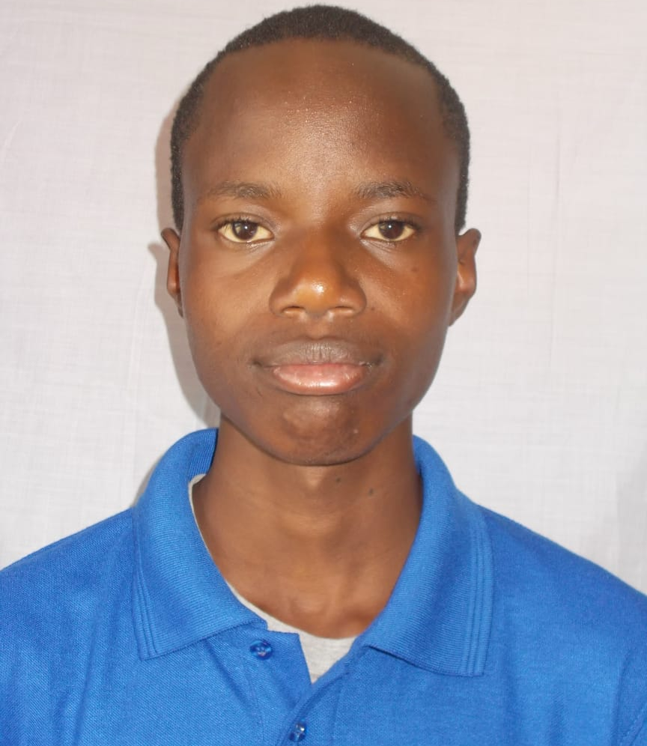
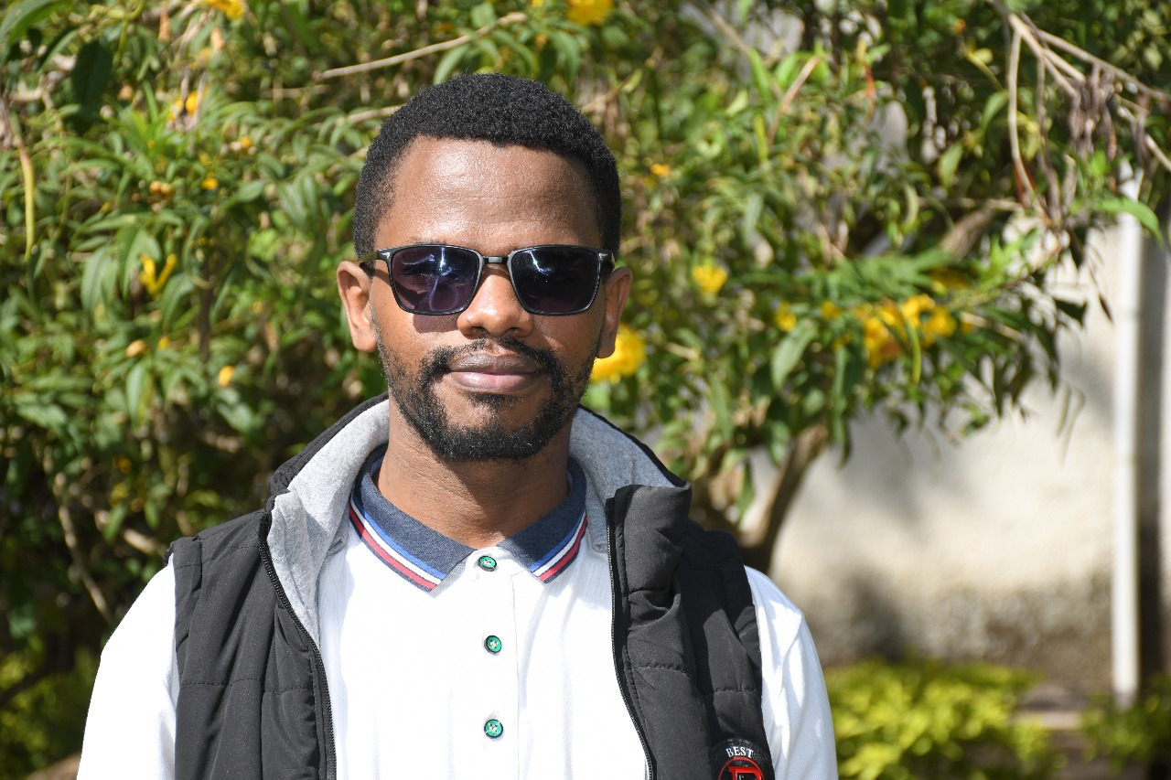
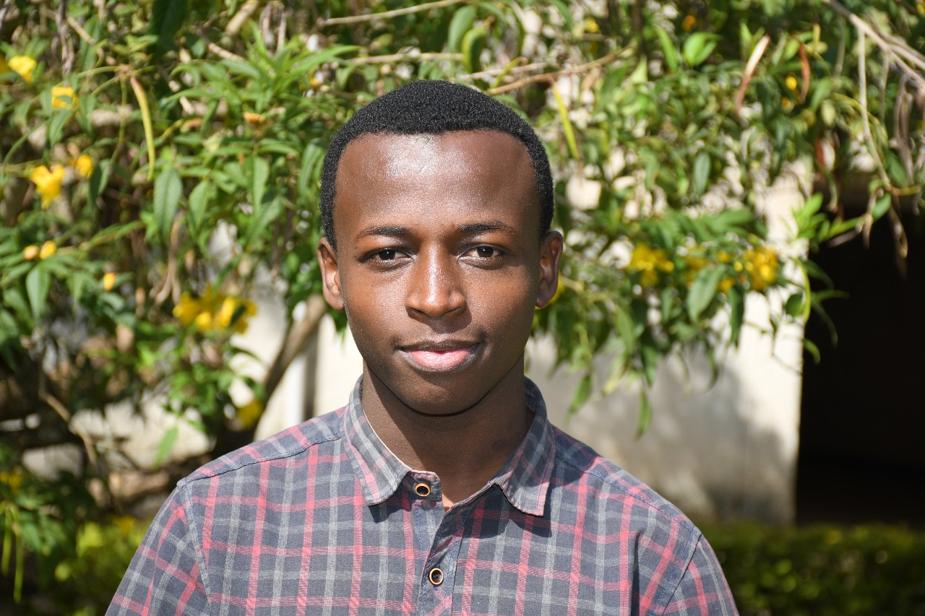

The team
Daniel Wekesa
Geoffrey Gitay
Josiah Ndirangu
Richard Karanu
Lameck Kipchumba
Frontend Developer
Backend Developer
Project manager
Group lead
AI/ML Engineer
UI/UX Design

Slide 7
How it works
Step 3
Step 2
Step 1
AI processes the question and generates a response.
Chatbot converts speech to text.
User asks a question via text or voice input.

Slide 8

The technology:
Speech-to-Text (STT)
Text-to-Speech (TTS)
AI & Machine Learning Models
Natural Language Processing (NLP)

